Slide 1
C PROGRAMMING FOR 10TH GRADE
Nepali SEE Syllabus

Slide 2
INTRO TO STRUCTURED PROGRAMMING
Structured programming is a method of programming where you would design the program, integrate small logical units(called modules), so that the program becomes comprehensive, easy-to-read, and can be revised/fixed later on as well.
As it is in top-down model, it discourages the use of statements such as GOTO, JUMP, etc.
Examples of structured programming languages are: C, Python, PLI, Ada, Java(although it is mostly OOP), QBASIC, etc.

Slide 3
Top-down design
It is the process of writing large/complicated programs, and then dividing them into smaller modules to make it easier for editing/reading.
These sub-modules can be easily edited as per the user’s wish.

Slide 4
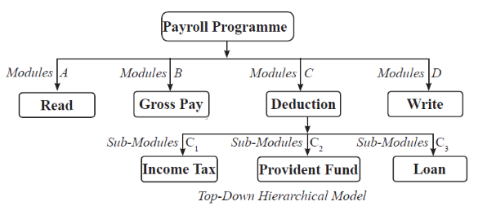
How top-down design works

Slide 5
Concept of one-entry one-exit
The main feature of structured programming is the one-entry one-exit concept. This basically means that the modules only have one entry point, and one exit point.
This concept can be achieved from these control structures:
1. Sequence Structure
2. Selection Structure
3. Looping Structure

Slide 6
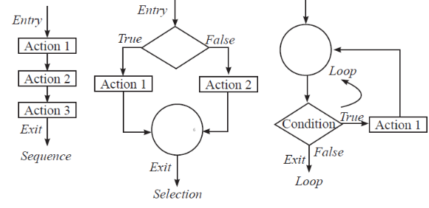
Flowchart for structured programming

Slide 7
What are the advantages of structured programming?
It is very easy to write a program in structured programming.
It has reduced complexity.
It is less time consuming compared to unstructured programming.
It is easier to maintain, edit, and look over the actual program.
Module can be reused multiple times.
Flow of control is very clear(top-down).

Slide 8
C PROGRAMMING
C programming was developed by Bell Labs in the early 1970s, and still continues to be one of the most popular programming languages to date due to it’s extremely fast and machine-independent nature. It has the feature of “Divide and Conquer”, to turn a very large program into many sub-modules, without loss of functionality.
The first major use of C-Programming was to write an OS called UNIX(Uniplexed Information and Computing Service).
C programming was actually derived from another programming language called B.

Slide 9
The types of C programming
Common C
ANSI C(American National Standards Institute)
Due to common C being the first version of C language, there were many errors, many inconsistencies, so till this day ANSI C is taken as the standard C programming language.

Slide 10
FEATURES OF C PROGRAMMING
Structured
Very fast
Case sensitive
Extendable
Readability

Slide 11
DISADVANTAGE OF C PROGRAMMING
No run time type checking
Does not support OOP
C Language only has 32 keywords
It provides no data protection
C compilers can only identify errors, and are incapable of handling exceptions.
It is incapable of handling run time errors.

Slide 12
QBASIC VS C
Similarities:
Both of them are high level languages.
Both support structured programming.
Both can use local and global variable.
Dissimilarities:
QBASIC only supports high level programming, while C supports both high level and low level.
C only supports function procedure.
C programming has more data types than QBASIC.

Slide 13
APPLICATIONS OF C PROGRAMMING
C programming was initially used for developing systems, specifically operating systems.
C programming is used to make systems as it can run it’s code almost as fast as assembly code, with much more readability.
Some applications are:
OS
Language Compilers
Assemblers
Text Editors
Print spoolers

Slide 14
IMPORTANT NOTES FOR CODING
PLEASE DO NOT FORGET TO ADD SEMICOLON WHERE NECESSARY!!!
Compilation meaning: It is the process of changing the source code of the program into machine code.
Data types in C:
Basic Data Types: int, char, float, double, long, unsigned
Derived Data Types: arrays, pointers, structures, unions, enums

Slide 15
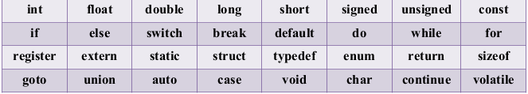
MORE NOTES
Keywords:
Keyword is a set of special words which are already defined for some tasks. C only has a set of 32 keywords. These words are also known as “reserved words”.

Slide 16
MORE NOTES
Preprocessor directories:
It is basically a set of code that is executed at the beginning of the compilation process. Example: #include <stdio.h>
Format specifier:
The format specifier is used during input and output operation. It tells the compiler what type of data is storied in a variable during the input and output operations.

Slide 17
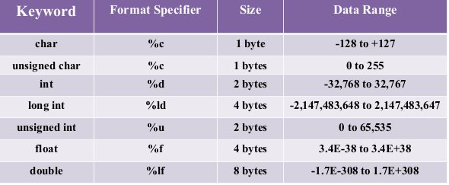
FORMAT SPECIFIER TABLE

Slide 18
Time to get into the actual programming

